Slide 1


Designing Highly Efficient LXI-based Systems
Tom Sarfi, VTI Instruments

Slide 2
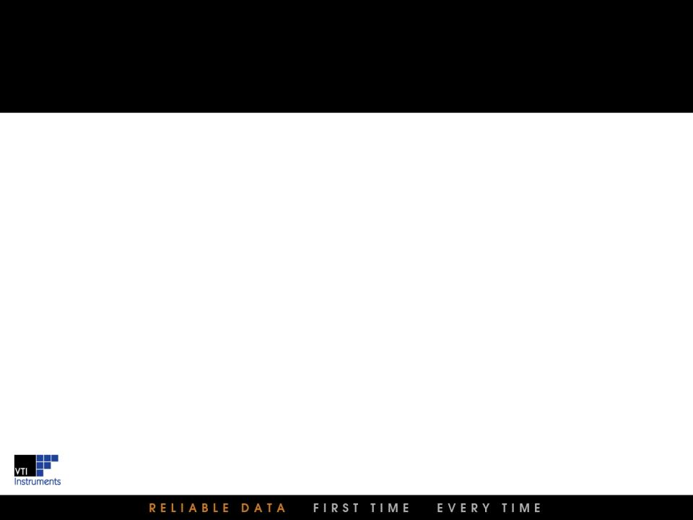
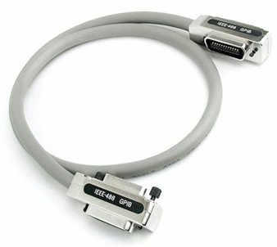
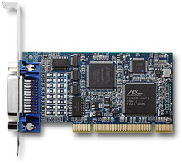
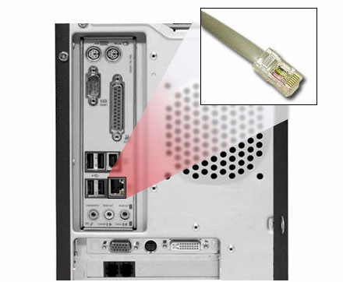
The Case for LAN in ATE And making it viable in a T&M environment
The Case for LAN in ATE
Comms Type | Serial
Bus Speed | 12.5 MB/s (100 base-T)
 | 125 MB/s (Gigabit)*
Host Interface (Cost) | LAN Port, embedded (NA)
Cabling(Cost) | CAT5e ($5)
Max cable length | 100M-1kM to limitless
Addressing | Static IP - Soft programmable
 | AutoIP
 | DHCP Assigned
Multi-instrument control | Ethernet Switch
Max # of Instruments | NA
Power options | PoE capability
Ubiquity Level | Extremely High/Pervasive
The Need for LXI in ATE
Interoperability | Conformance testing required
Software drivers | IVI (per specification)
 | SCPI support (vendor dependent)
Device Synchronization* | IEEE-1588 (PTP)
Instr-Instr Handshaking* | LAN Events
 | Wired-Trigger Bus

Slide 3
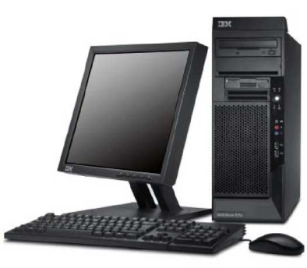
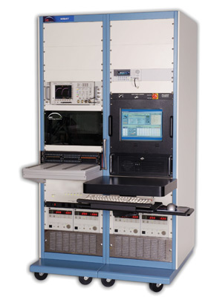
Test Programming Paradigm Communicating between the controller and the ATE
High degree of variability
Application Code
C++
LabVIEW
JAVA
Instrument Driver (API)
IVI
VXIplug&play
SCPI command set
Hardware Driver
VISA/Device Driver
DMA
SICL
Transmission Mechanism
GPIB/Word Serial
DMA (PCI-PCI, PCI-VME)
TCP/IP
GPIB, cabled PCIe, MXI2, Ethernet, USB

Slide 4
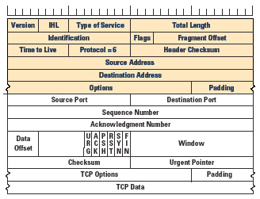
TCP/IP Protocol Overhead Data transmission reliability
Allowable Ethernet Transport Layers in LXI
TCP – guaranteed data transmission
UDP – sometimes referred to as “unreliable” protocol, possible but unlikely to lose data packets (LXI specification 3.3.4 Observation)
More ‘baggage’ required to ensure data delivery using TCP/IP
IPV6 has larger address fields
IP Header
TCP Header
TCP Data

Slide 5
LAN Speed Test – Gigabit Link Characterizing the Impact of Overhead
Laptop – Win7
Desktop - XP
Switch
Switch
Dual Core 2.53 GHz 4 GB Ram 64 bit OS
Total cable length ~ 100 feet
Dual Core 3.22 GHz 3 GB Ram 32 bit OS
TCP Connection: All measured times are roundtrip, (includes both request and reply).
Time to open TCP connection is not included.
Client – Server setup
Client sends a 24 byte data packet containing requested data length of reply.
Server returns packet(s) with total data length of 16+requested length.
Frame overhead is 54 bytes (not included in any of the above).
Both NIC’s have TCP Offload capability.

Slide 6
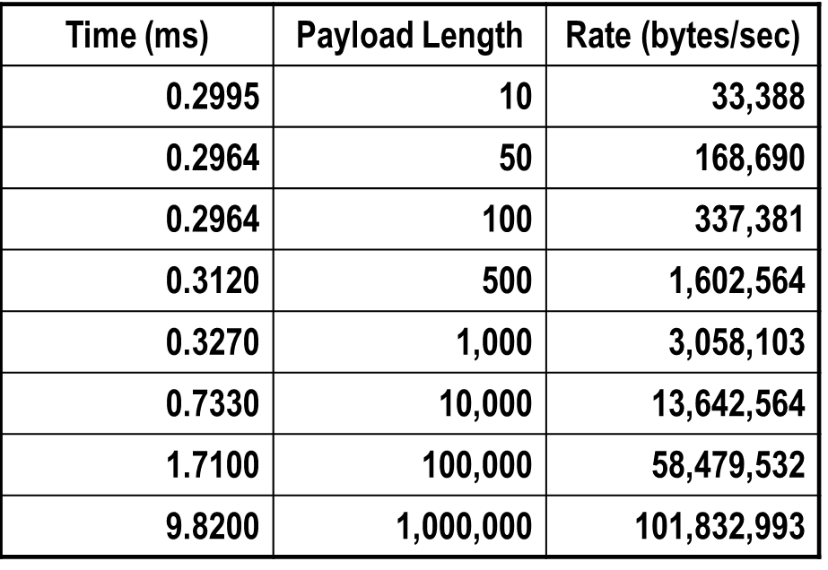
Some LAN Speed Test Results – Gigabit Link Carry as much as you can on a trip
Laptop – Win7
Desktop - XP
Switch
Switch
Dual Core 2.53 GHz 4 GB Ram 64 bit OS
Total cable length ~ 100 feet
Dual Core 3.22 GHz 3 GB Ram 32 bit OS

Slide 7
How an Instrument can Impact Test Time Some measurements take time
Digital Multimeters
Aperture times (can be 10’s of ms for high accuracy measurements)
Settling times associated with range and function changes
Mechanical switch settling time
3 ms – 50 ms depending on application
Simultaneous sampling digitizers
# of acquired samples/sample rate
Power Supply Settling Times
Overly Simplified View of Measurement Cycle Time
Protocol Overhead
CMD
Instrument Action
e.g, arm/trig/integrate
Protocol Overhead
CMD
Protocol Overhead
Data
Send CMD
E.g. Init Measurement
Query operation complete status
Request Response
e.g; Fetch Data
Instrument Send Data
Send CMD
Send CMD
Send CMD
In many applications, the overhead is a negligible percentage of overall cycle time
Shipping more data in one packet also reduces the impact on test time

Slide 8
Creating a More Efficient Test System Case Study - Developing More Efficient Instrument Drivers
Replace a MXI2 slot 0 interface with gigabit LXI-VXI interface
Enables VXI to be used in a distributed environment
Simplified infrastructure, no PCI plug-in needed
Drop-in replacement, no code change needed for compatibility
100 kSa/s digitizer in VXI chassis
16 simultaneous sampling channels, 128 kSa memory depth per channel (4MB total)
Use soft front panel to acquire data and download to PC
Initial test results were abysmal, 1.28 seconds to acquire the data, minutes to offload
Looked at underlying code, VISA viIn16 calls were being used to pull data from memory
The data was being sent to the PC one sample at a time!
Replaced viIn16 with viMove calls – retrieve data in blocks to reduce protocol hit
All data returned in less than 1 second, negligible difference between the two interfaces

Slide 9
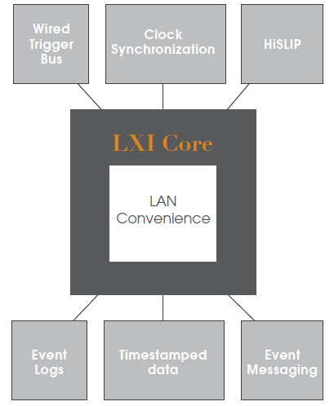
Creating a More Efficient Test System Integrate a more powerful infrastructure using extended functions
LXI Extended Functions

Slide 10

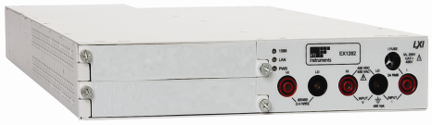
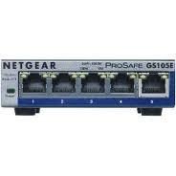
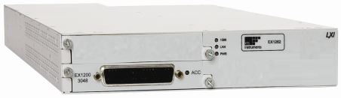
Case Study – Switch/Measure Applications
Temperature/Voltage Monitoring, Continuity/Isolation
Test Case Parameters
Host PC | Dell E5520, i5 CPU @ 2.5 GHz
Ethernet Switch | SMC8505T 10/100/1000
6.5 Digit DMM | VTI EX1262
Multiplexer | EX1202/EX1200-3048 (48 ch)
Measurements | 384
DMM Aperture | 1.67 ms
DMM Function | Fixed (DCV)
DMM Range | Fixed (100 V)
Switch Settling | 5 ms (Electromechanical)
Host Controller
6.5 Digit DMM
ENET Switch
48 ch. Mux
INSTRUMENTATION/APPLICATION VARIABLES:
DMM Aperture/Resolution
DMM Function and/or range changes (delays)
DMM Autozero
Switch Settling Time
48 Analog Signals

Slide 11
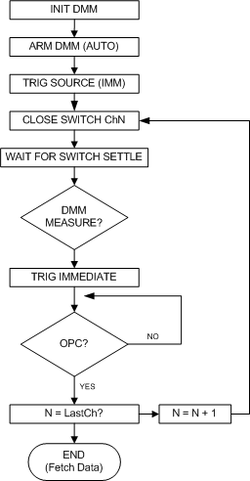
Case Study – Switch/Measure
Software/Application code pacing
Removing all variables, best case scenario
1 / (1.67 ms + 5 ms) * 384 = 2.56 seconds
150 readings/second
Send Command Close ChN
Variable
Wait for Switch Settle
5 ms
Send DMM Measure Command
Variable
Poll on DMM Measure Complete
(or wait)
1.67 ms
Send Command Open ChN
Variable
Actual Measured:
Protocol overhead carried for every switch measure loop

Slide 12
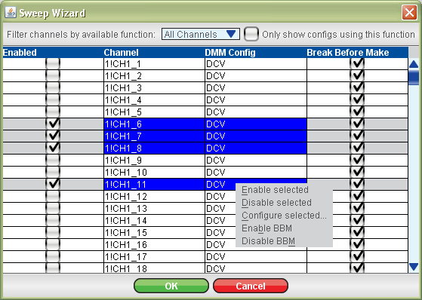

Creating a More Efficient Test System Integrating Intelligent Instruments
Integrated Switch/Measure into one instrument
Modular DMM and Multiplexer
Scanning sequence can be built using graphical interface, or through API
Scan list resides in on-box memory
On-box processor paces the sequencing
The only host intervention that is required is to initiate the scan and retrieve the data
Internal analog bus reduces external wiring
Actual Measured: 150 rdgs/s
There is minimal impact due to protocol overhead

Slide 13
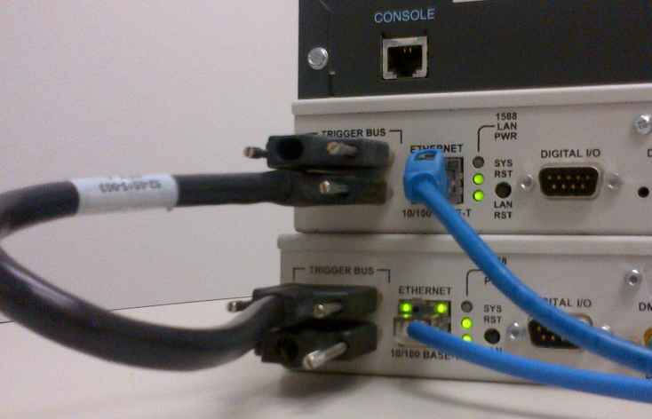
The LXI Wired Trigger Bus (WTB) Extension
Emulating modular architecture backplanes
Analogous to VXI and PXI trigger bus
Familiar hardware-based model for triggering and handshaking between discrete modules
Eight (8) mLVDS lines with wired-or operation
Supports segmented trigger bus lanes
Systems can extend beyond the eight trigger lines
Separate scan list in DMM and Switch
Sequencing paced by trigger pulses passed across WTB when measurement is complete or switch has settled
The only host intervention that is required is to initiate the scan and retrieve the data
LXI0 = MeasCompl -> advances to next element in switch scan list
LXI1 = SwitchSettle -> triggers DMM to take measurement
WTB Termination
Actual Measured: 145 rdgs/s
Again, there is minimal impact due to protocol overhead

Slide 14
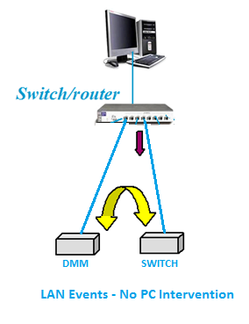
LXIsync LAN Event Triggering
Peer-Peer messages over CAT5e
LXI LAN Events
Peer-peer multicast architecture
LAN messages are sent over the wire as triggers
DMM sends “Measure Complete” event LAN0 which the switch uses to advance scan list
Switch sends “Switch Settled” event LAN1 which the DMM uses to initiate a measurement
LAN signals are converted to backplane signals within each instrument
IEEE-1588 implementation
Events are sent with timestamps, each instrument uses the timestamp as the trigger event
Synchronization typically around 10s of us
Initial results were TERRIBLE! (Lesson learned – l started the test right after powering up the box – did not give the two instruments a chance to become synchronized)
Actual Measured: 92 rdgs/s
Processing LAN events/implementation impacting efficiency

Slide 15
Comparing Results
Choose the best fit for the application
Method (Electromechanical, 5 ms settle) | Measured
Software Pacing | 63 rdgs/sec
Integrated/Internal Scan Engine | 150 rdgs/sec
LXI WTB Handshaking | 145 rdgs/sec
LXI LAN Event Handshaking | 92 rdgs/sec
Theoretical Max | 150 rdgs/s
Determinism
Software Pacing | Below Average
Integrated/Internal Scan Engine | Excellent
LXI WTB Handshaking | Excellent
LXI LAN Event Handshaking | Average
Method (Solid-State, 0.2 ms ON time) | Measured
Software Pacing | 60 rdgs/sec
Integrated/Internal Scan Engine | 535 rdgs/sec
LXI WTB Handshaking | 522 rdgs/sec
LXI LAN Event Handshaking | 123 rdgs/sec
Theoretical Max | 535 readings/s
Resolution of WAIT statement

Slide 16
Summary
TCP/IP protocol carries overhead with every message sent over the wire
Testing shows about 300 us per message
Using UDP can reduce this by an order of magnitude, but data delivery not guaranteed
For many applications, this can be imperceptible
Smart instruments minimize host intervention
Instrument driver structure/application code can have a significant impact
Incorporate the most efficient programming model available
LXI extended functions can be used to overcome the impact of overhead
LXI WTB offers backplane-like performance
LXI LAN Events can be efficient for distributed applications
LXI extended functions can be used to overcome the impact of overhead
LXI-based test systems can be architected for efficiency

